Slide 1
Final Exam

Slide 2
Chapter 2

Slide 3
5 Usable Ethical Theories
Thursday Jan. 17 and Tuesday Jan. 22

Slide 4
2.6 Kantianism

Slide 5
Critical Importance of Good Will
Good will: the desire to do the right thing
Immanuel Kant: Only thing in the world that is good without qualification is a good will
XS – what is an example of happiness that is at odds with a good will?
Reason should cultivate desire to do right thing

Slide 6
Categorical Imperative (1st Formulation)
Act only from moral rules that you can at the
same time will to be universal moral laws.

Slide 7
Illustration of 1st Formulation
Question: Can a person in dire straits make a promise with the intention of breaking it later?
Proposed rule: “I may make promises with the intention of later breaking them.”
The person in trouble wants his promise to be believed so he can get what he needs.
Universalize rule: Everyone may make & break promises
Everyone breaking promises would make promises unbelievable, contradicting desire to have promise believed
The rule is flawed. The answer to the question is “No.”

Slide 8
Another Way to Reason It Out
Question: Can I make a promise with the intention of breaking it later?
I want my false promise to be believed.
In order for my false promised to be believable, I want everyone except myself to be truthful all the time.
In other words, I want to privilege my needs and desires over those of everyone else.
Contradiction between what I want to do and what I want others to do.
Therefore, what I am considering doing is wrong.

Slide 9
A Quick Check
When evaluating a proposed action, reverse roles
What would you think if that person did the same thing to you?
Negative reaction → evidence that your will to do that action violates the Categorical Imperative

Slide 10
Categorical Imperative (2nd Formulation)
Act so that you treat both yourself
and other people as ends in themselves
and never only as a means to an end.
This is usually an easier formulation to work
with than the first formulation of the
Categorical Imperative.

Slide 11
Kant: Wrong to Use Another Person Solely as a Means to an End

Slide 12
Plagiarism Scenario (p. 70)
Carla
Single mother
Works full time
Takes two evening courses/semester
History class
Requires more work than normal
Carla earning an “A” on all work so far
Carla doesn’t have time to write final report
Carla purchases report; submits it as her own work

Slide 13
Kantian Evaluation (1st Formulation)
Carla wants credit for plagiarized report
Rule: “You may claim credit for work performed by someone else”
If rule universalized, reports would no longer be credible indicator’s of student’s knowledge, and professors would not give credit for reports
Proposal moral rule is self-defeating
It is wrong for Carla to turn in a purchased report

Slide 14
Kantian Evaluation (2nd Formulation)
Carla submitted another person’s work as her own
She attempted to deceive professor
She treated professor as a means to an end
End: passing the course
Means: manipulate professor
What Carla did was wrong

Slide 15
Case for Kantianism
Treats all persons as moral equals
Gives all people moral worth as rational, autonomous beings
Holds everyone to the same standard
Produces universal moral guidelines

Slide 16
Perfect and Imperfect Duties
Perfect duty: duty obliged to fulfill without exception
Example: Telling the truth
Imperfect duty: duty obliged to fulfill in general but not in every instance
Example: Helping others
XS – multiple means of carrying it out.

Slide 17
Case Against Kantianism
Sometimes no rule adequately characterizes an action
Sometimes there is no way to resolve a conflict between rules
In a conflict between a perfect duty and an imperfect duty, perfect duty prevails
In a conflict between two perfect duties, no solution
Kantianism allows no exceptions to perfect duties
Conclusion: Despite weaknesses, a workable ethical theory

Slide 18
2.7 Act Utilitarianism

Slide 19
Principle of Utility
Jeremy Bentham and John Stuart Mill
An action is good if its benefits exceeds its harms
An action is bad if its harms exceed its benefits
Utility: tendency of an object to produce happiness or prevent unhappiness for an individual or a community
Happiness = advantage = benefit = good = pleasure
Unhappiness = disadvantage = cost = evil = pain

Slide 20
Principle of Utility (Greatest Happiness Principle)
An action is right (or wrong) to the extent
that it increases (or decreases) the
total happiness of the affected parties.
- XS – *decreases least

Slide 21
Principle of Utility

Slide 22
Act Utilitarianism
Utilitarianism
Morality of an action has nothing to do with intent
Focuses on the consequences
A consequentialist theory
Act utilitarianism
Add up change in happiness of all affected beings
Sum > 0, action is good
Sum < 0, action is bad
Right action to take: one that maximizes the sum

Slide 23
Bentham: Weighing Pleasure/Pain
Intensity
Duration
Certainty
Propinquity (nearness)
Fecundity (able to produce more)
Purity (not diluted by pleasure/pain)
Extent (number of people)

Slide 24
Highway Routing Scenario
State may replace a curvy stretch of highway
New highway segment 1 mile shorter
150 houses would have to be removed
Some wildlife habitat would be destroyed

Slide 25
Evaluation
Costs
$20 million to compensate homeowners
$10 million to construct new highway
Lost wildlife habitat worth $1 million
Benefits
$39 million savings in automobile driving costs
Conclusion
Benefits exceed costs
Building highway a good action

Slide 26
Case for Act Utilitarianism
Focuses on happiness
Down-to-earth (practical)
Comprehensive

Slide 27
Case Against Act Utilitarianism
Unclear whom to include in calculations and how far out into the future to consider
Too much work
Ignores our innate sense of duty
We cannot predict consequences with certainty
Susceptible to the problem of moral luck
Conclusion: Overall, a workable ethical theory

Slide 28
2.8 Rule Utilitarianism

Slide 29
Applying Principle of Utility to Rules
We ought to adopt moral rules which, if followed by everyone, will lead to the greatest increase in total happiness
Act utilitarianism applies Principle of Utility to individual actions
Rule utilitarianism applies Principle of Utility to moral rules

Slide 30
Anti-Worm Scenario
August 2003: Blaster worm infected thousands of Windows computers
Soon after, Nachi worm appeared
Took control of vulnerable computer
Located and destroyed copies of Blaster
Downloaded software patch to fix security problem
Used computer as launching pad to try to “infect” other vulnerable PCs

Slide 31
Evaluation using Rule Utilitarianism
Proposed rule: If I can write a helpful worm that removes a harmful worm from infected computers and shields them from future attacks, I should do so
Who would benefit
People who do not keep their systems updated
Who would be harmed
People who use networks
People who’s computers are invaded by buggy anti-worms
System administrators
Conclusion: Harm outweighs benefits. Releasing anti-worm is wrong.

Slide 32
Case for Rule Utilitarianism
Not every moral decision requires performing utilitarian calculus
Moral rules survive exceptional situations
Avoids the problem of moral luck
Reduces the problem of bias (xs – in act utilitarianism)
Appeals to a wide cross-section of society (xs - consequentialist)

Slide 33
Case Against Utilitarianism in General
All consequences must be measured on a single scale.
All units must be the same in order to do the sum
In certain circumstances utilitarians must quantify the value of a human life (xs – e.g. project zero attempts to save lives by reducing speeds)
Utilitarianism ignores the problem of an unjust distribution of good consequences.
Utilitarianism does not mean “the greatest good of the greatest number”
XS – it does not require goods to be distributed equally, but does it tend toward it?
That requires a principle of justice
What happens when a conflict arises between the Principle of Utility and a principle of justice?
Conclusion: Despite weaknesses, both act utilitarianism and rule utilitarianism are workable ethical theories

Slide 34
2.9 Social Contract Theory

Slide 35
Basis of Social Contract Theory
Thomas Hobbes
In a “state of nature” our lives would be “solitary, poore, nasty, brutish, and short”
We implicitly accept a social contract
Establishment of moral rules to govern relations among citizens
Government capable of enforcing these rules
Jean-Jacques Rousseau
In ideal society, no one above rules
That prevents society from enacting bad rules

Slide 36
James Rachels’s Definition
“Morality consists in the set of rules (1),
governing how people are to
treat one another, that rational
people will agree to accept (2), for their
mutual benefit (3), on the condition that
others follow those rules as well (4).”

Slide 37
Kinds of Rights
Negative right: A right that another can guarantee by leaving you alone
Positive right: A right obligating others to do something on your behalf
Absolute right: A right guaranteed without exception
Limited right: A right that may be restricted based on the circumstances

Slide 38
Correlation between Types of Rights
Positive rights tend to be more limited
Negative rights tends to be more absolute

Slide 39
John Rawls’s Principles of Justice
Each person may claim a “fully adequate” number of basic rights and liberties, so long as these claims are consistent with everyone else having a claim to the same rights and liberties
Any social and economic inequalities must
Be associated with positions that everyone has a fair and equal opportunity to achieve
Be to the greatest benefit of the least-advantaged members of society (the difference principle)

Slide 40
Rawls’s First Principle of Justice

Slide 41
Rawls’s Difference Principle

Slide 42
DVD Rental Scenario (pp.85-6)
Bill owns chain of DVD rental stores
Collects information about rentals from customers
Constructs profiles of customers
Sells profiles to direct marketing firms
Some customers happy to receive more mail order catalogs; others unhappy at increase in “junk mail”

Slide 43
Evaluation (Social Contract Theory)
Consider rights of Bill, customers, and mail order companies.
Does customer have right to expect name, address to be kept confidential?
If customer rents DVD from bill, who owns information about transaction?
If Bill and customer have equal rights to information, Bill did nothing wrong to sell information.
If customers have right to expect name and address or transaction to be confidential without giving permission, then Bill was wrong to sell information without asking for permission.

Slide 44
Case for Social Contract Theory
Framed in language of rights
Explains why people act in self-interest in absence of common agreement
Tragedy of the commons
Provides clear analysis of certain citizen/government problems
Why okay for government to deprive criminals of certain rights
Why civil obedience can be morally right action

Slide 45
Case Against Social Contract Theory
No one signed social contract
Some actions have multiple characterizations
Conflicting rights problem
May unjustly treat people incapable of upholding contract
Conclusion: Despite weaknesses, a workable theory

Slide 46
2.10 Virtue Ethics

Slide 47
Critique of Enlightenment Theories
Kantianism, utilitarianism, social contract theory ignore important moral considerations
moral education
moral wisdom
family and social relationships
role of emotions
Virtue ethics
arete, virtue, excellence: reaching highest potential
Aristotle’s Nicomachean Ethics (4th century BC)

Slide 48
Virtues and Vices
Two types of virtue
intellectual virtues: virtues associated with reasoning and truth
moral virtues: virtues of character (e.g., honesty)
Moral virtues
developed by habitually performing right action
deep-seated character traits
disposition to act in a certain way and feel in a certain way

Slide 49
Aristotle: Happiness derives from living a life of virtue.

Slide 50
Summary of Virtue Ethics
A right action is an action that a virtuous person, acting in character, would do in the same circumstances.
A virtuous person is a person who possesses and lives out the virtues.
The virtues are those character traits human beings needs in order to flourish and be truly happy.

Slide 51
Vices
Vices are opposite of virtues (xs – careful interpreting this, see below)
Vice: a character trait that prevents a human being from flourishing or being truly happy
Often, a virtue situated between two vices
Courage between cowardliness and rashness
Generosity between stinginess and prodigality

Slide 52
Aristotle’s Virtues and Vices (XS)
Vice (excess) | Virtue (mean) | Vice (deficienc
Rashness | Courage | Cowardice
Overindulgence | Temperance | Insensibility
Wastefulness | Liberality | Meanness
Vulgarity | Magnificence | Stinginess
Ambition | Proper ambition/pride | Undue humility
Irascibility | Patience | Lack of spirit
Tactlessness | Truthfulness | Casual Lying
Buffoonery | Wittiness | Boorishness
Fawning | Friendliness | Cantankerousness
Shyness | Modesty/Shame | Shamelessness
Egotism | Justice | Self-sacrificing

Slide 53
Case for Virtue Ethics
It often makes more sense to focus on virtues than obligations, rights, or consequences
Personal relationships can be morally relevant to decision making
Theory recognizes our moral decision-making skills develop over time
With this theory there are no irresolvable moral dilemmas
Emotions play an important role in living a moral life

Slide 54
Case Against Virtue Ethics
Reasonable people may disagree on character traits needed for human flourishing
Cannot use virtue ethics to guide government policy
Virtue ethics undermines attempts to hold people responsible for their bad actions
Conclusion: Despite weaknesses, virtue ethics a workable theory

Slide 55
2.11 Comparing Workable Ethical Theories

Slide 56
Ethical Objectivism vs. Relativism
Ethical objectivism: Morality has an existence outside the human mind
Relativism: Morality is a human invention
Divine command theory, ethical egoism, Kantianism, utilitarianism, social contract theory, and virtue ethics examples of ethical objectivism

Slide 57
Workable Ethical Theories
We seek theories with these characteristics:
Based on the ethical point of view
Objective moral principles developed using logical reasoning based on facts and commonly held values
Workable ethical theories
Kantianism
Act and rule utilitarianism
Social contract theory
Virtue ethics

Slide 58
Comparing Workable Ethical Theories

Slide 59
2.12 Morality of Breaking the Law

Slide 60
Social Contract Theory Perspective
Everyone in society bears certain burdens in order to receive certain benefits
Legal system supposed to guarantee people’s rights are protected
Everything else being equal, we should be law-abiding
Should only break law if compelled to follow a higher-order moral obligation

Slide 61
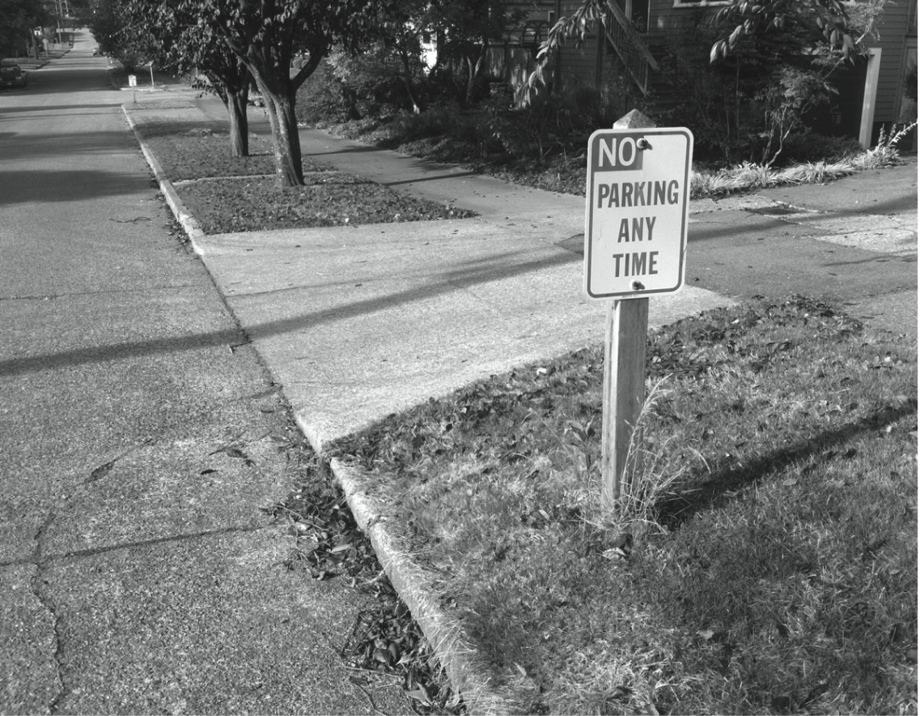
Social Contract: A Prima Facie Obligation to Obey the Law

Slide 62
Kantian Perspective
Everyone wants to be treated justly
Imagine rule: “I may break a law I believe to be unjust”
If everyone acted according to this rule, then laws would be subverted
Contradiction: Cannot both wish to be treated justly and allow laws to be subverted

Slide 63
Rule Utilitarian Perspective
What would be consequences of people ignoring laws they felt to be unjust?
Beneficial consequence: Happiness of people who are doing what they please
Harmful consequences: Harm to people directly affected by lawless actions, general loss of respect for laws, increased burden on criminal justice system
Harms greater than benefits

Slide 64
Act Utilitarian Perspective
Possible to conceive of situations where benefits of breaking law exceed harms
Suppose give penniless, bedridden friend copy of CD
Friend benefits by $15 (value of CD)
I benefit by $10 (satisfaction of helping friend)
Harms of $0 (no lost sale, no police involvement)
With $25 of benefit and $0 of harm, action is determined to be good

Slide 65
Summary

Slide 66
Insights Offered by Various Theories
Kantianism: Every person is equally valuable, and when you interact with other people you should always respect them as rational beings. It is wrong to privilege your needs and desires over those of other people.
Utilitarianism: You should consider the consequences of an action before deciding whether it’s right or wrong.
Social contract theory: We should collectively promote human rights, such as the rights to life, liberty, and property.
Virtue ethics: You can count on a good person to do the right thing at the right time in the right way.

Slide 67
It’s Up to You
You can consider duties and rights and consequences and virtues when making moral decisions
Ultimately, you have to decide:
What kind of person do I want to be?
What kind of world do I want to live in?

Slide 68
Chapter 3

Slide 69
3.5 Censorship

Slide 70
Forms of Direct Censorship
Government monopolization
Prepublication review
Licensing and registration

Slide 71
Self-censorship
Most common form of censorship
Group decides for itself not to publish
Reasons
Avoid subsequent persecution
Maintain good relations with government officials (sources of information)
Ratings systems created to advise potential audience
Movies, TVs, CDs, video games
Not the Web

Slide 72
Challenges Posed by the Internet
Many-to-many communications
Dynamic connections
Huge numbers of Web sites
Extends beyond national borders, laws
Hard to distinguish between minors and adults

Slide 73
Governmental Filtering and Surveillance
North Korea: Internet virtually inaccessible
Saudi Arabia: centralized control center
China
Blocks Internet access at times of social unrest
Has “one of most sophisticated filtering systems in the world”
Germany: Forbids access to neo-Nazi sites
United States: Repeated efforts to limit access of minors to pornography

Slide 74
Ethical Perspectives on Censorship
Kant opposed censorship
Enlightenment thinker
“Have courage to use your own reason”
Mill opposed censorship
No one is infallible
Any opinion may contain a kernel of truth
Truth revealed in class of ideas
Ideas resulting from discourse are more influential

Slide 75
Mill’s Principle of Harm
“The only ground on which intervention
is justified is to prevent harm to others;
the individual’s own good is not a
sufficient condition.”

Slide 76
Chapter 4

Slide 77
What Is Intellectual Property?
Intellectual property: any unique product of the human intellect that has commercial value
Books, songs, movies
Paintings, drawings
Inventions, chemical formulas, computer programs
Intellectual property ≠ physical manifestation
Does right to own property extend to intellectual property?

Slide 78
Property Rights
Locke: The Second Treatise of Government
People have a right…
to property in their own person
to their own labor
to things which they remove from Nature through their labor
As long as…
nobody claims more property than they can use
after someone removes something from common state, there is plenty left over

Slide 79
4.4 Fair Use

Slide 80
Fair Use Concept
Sometimes legal to reproduce a copyrighted work without permission
Courts consider four factors
Purpose and character of use
Nature of work
Amount of work being copied
Affect on market for work

Slide 81
Sony v. Universal City Studios
Sony introduced Betamax VCR (1975)
People started time shifting TV shows
Movie studios sued Sony for copyright infringements
U.S. Supreme Court ruled (5-4) that time shifting is fair use

Slide 82
Time Shifting

Slide 83
Digital Recording Technology
Copying from vinyl records to cassette tapes introduced hiss and distortions
Introduction of compact disc a boon for music industry
Cheaper to produce than vinyl records
Higher quality
Higher price ⇒ higher profits
BUT it’s possible to make a perfect copy of a CD

Slide 84
Audio Home Recording Act of 1992
Protects rights of consumers to make copies of analog or digital recordings for personal, noncommercial use
Backup copy
Give to family member
Digital audio recorders must incorporate Serial Copyright Management System (SCMS), so consumers can’t make a copy of a copy

Slide 85
RIAA v. Diamond Multimedia
MP3 compression allowed songs to be stored in 10% of the space, with little degradation
Diamond introduced Rio MP3 player (1998)
People started space shifting their music
RIAA started legal action against Diamond for violation of the Audio Home Recording Act
U.S. Court of Appeals, 9th Circuit, affirmed that space shifting is consistent with copyright law

Slide 86
Space Shifting

Slide 87
Kelly v. Arriba Soft
Kelly: Photographer maintained Web site with copyrighted photos
Arriba Soft: Created search engine that returned thumbnail images
Kelly sued Arriba Soft for copyright infringement
U.S. Court of Appeals, 9th Circuit, affirmed that it was fair use

Slide 88
Authors Guild v. Google (1/2)
Google announced plan to scan millions of books held by several huge libraries, creating searchable database of all words
If public domain book, system returns PDF
If under copyright, user can see a few sentences; system provides links to libraries and online booksellers
Authors Guild and publishers sued Google for copyright infringement (copying books for commercial reasons)
Judge ruled in favor of Google and dismissed lawsuit

Slide 89
Authors Guild v. Google (2/2)
Judge: Google Books is a fair use of copyrighted works
Purpose and character:
Purpose is to create a massive index
Character is highly transformative
Precedent: Kelly v. Arriba Soft Corporation
Weighs in favor of fair use
Nature of work being scanned: mostly nonfiction
Weighs in favor of fair use
How much being scanned: entire work
Weighs against fair use
Effect on the market: stimulating book sales
Weighs in favor of fair use

Slide 90
Mashups
A vs. B: instrumental track from one song + vocal track from another song
XS – Jay-Z + the Beatles = The Grey Album
Audio collage: create new composition from dozens of audio fragments
Fair use? Lae suggests…
Audio collage: yes
A vs. B: no, unless “criticism, satire, or parody”

Slide 91
Fair Use in Canada (XS – see Myths and Facts PDF)
In 1921, Canada’s Copyright Act included fair dealing as section 16.1(i), allowing fair dealing for the purposes of private study, research, criticism, review, or newspaper summary.
The purposes of parody, satire and education were added to the Act in 2012.
The Act states that copyright applies to uses of “the work or any substantial part thereof.”
A substantial part of a work can be used under fair dealing if it is for an allowable purpose and if the requirements of the Supreme Court of Canada’s six-factor test for fairness are met.

Slide 92
Six Factor Test
The Supreme Court of Canada’s 2004 CCH Canadian Ltd. v. Law Society of Upper Canada decision provides six non-exhaustive factors with which to determine the fairness of an intended use. These factors are: purpose, character, amount, alternatives, nature, and effect.

Slide 93
Definition of ‘substantial’
For example, the Copyright Board has stated that copying a page or two from a book (other than a book of short works) is not substantial and falls outside copyright, and that the use of up to 10 percent of a work does not affect the fairness of the dealing. For uses that fall under fair dealing, the Supreme Court has stated that “for the purpose of research or private study, it may be essential to copy an entire academic article or an entire judicial decision.”

Slide 94
4.9 Open-Source Software

Slide 95
Criticisms of Proprietary Software
Increasingly harsh measures being taken to enforce copyrights
Copyrights are not serving their purpose of promoting progress
It is wrong to allow someone to “own” a piece of intellectual property

Slide 96
Open-Source Definition
No restrictions preventing others from selling or giving away software
Source code included in distribution
No restrictions preventing others from modifying source code
No restrictions regarding how people can use software
Same rights apply to everyone receiving redistributions of the software (copyleft)

Slide 97
Beneficial Consequences of Open-Source Software
Gives everyone opportunity to improve program
New versions of programs appear more frequently
Eliminates tension between obeying law and helping others
Programs belong to entire community
Shifts focus from manufacturing to service

Slide 98
Examples of Open-Source Software
BIND
Apache
Sendmail
Android operating system for smartphones
Firefox and Chrome
OpenOffice.org
Perl, Python, Ruby, TCL/TK, PHP, Zope
GNU compilers for C, C++, Objective-C, Fortran, Java, and Ada

Slide 99
Screenshot from OpenOffice.org, a registered trademark of Apache Software Foundation. Copyright © 2012 by Apache Software Foundation. Reprinted with permission.

Slide 100
GNU Project and Linux
GNU Project
Begun by Richard Stallman in 1984
Goal: Develop open-source, Unix-like operating system
Most components developed in late 1980s
Linux
Linus Torvalds wrote Unix-like kernel in 1991
Combined with GNU components to make an O.S.
Commonly called Linux

Slide 101
Impact of Open-Source Software
Linux an alternative to proprietary versions of Unix
Linux operating system on 97% of the world’s 500 fastest supercomputers (as of June 2014)

Slide 102
4.10 Creative Commons

Slide 103
Streamlining Creative Re-use
Under current copyright law, eligible works are copyrighted the moment they are created
No copyright notice does not mean it’s okay to copy
Must contact people before using work
That slows down creative re-use
Free Creative Commons license indicates
Which kinds of copying are okay
Which rights are being retained
Flickr and Magnatune two well-known sites using Creative Commons licenses

Slide 104
Screenshot from Creative Commons. Copyright © 2011 by Creative Commons. Reprinted with permission.

Slide 105
Chapter 5

Slide 106
5.2 Perspectives on Privacy

Slide 107
Defining Privacy
Privacy related to notion of access
Access
Physical proximity to a person
Knowledge about a person
Privacy is a “zone of inaccessibility”
Privacy violations are an affront to human dignity
Too much individual privacy can harm society
Where to draw the line?

Slide 108
XS – critical questions about privacy
Can a person harm you without you realizing it?
What are the benefits of privacy?
What are the harms of privacy?

Slide 109
Harms of Privacy
Cover for illegal or immoral activities
Burden on the nuclear family
Hidden dysfunctional families
People on society’s fringes can be ignored

Slide 110
Benefits of Privacy
Individual growth
Individual responsibility
Freedom to be yourself
Intellectual and spiritual growth
Development of loving, trusting, caring, intimate relationships

Slide 111
Is There a Natural Right to Privacy?
Privacy rights stem from property rights: “a man’s home is his castle”
Coercive Acts before American Revolution led to 3rd Amendment to U.S. Constitution
Prohibits quartering soldiers in private homes

Slide 112
XS - Perspectives on Privacy Rights
Samuel Warren and Louis Brandeis: People have “the right to be let alone.”
Mental strain of press attention.
Judith Jarvis Thomson: “Privacy rights” overlap other rights
Conclusion: Privacy is not a natural right, but it is a prudential right
Prudential rights: rights that society has because rational agents recognize the benefits of these rights.

Slide 113
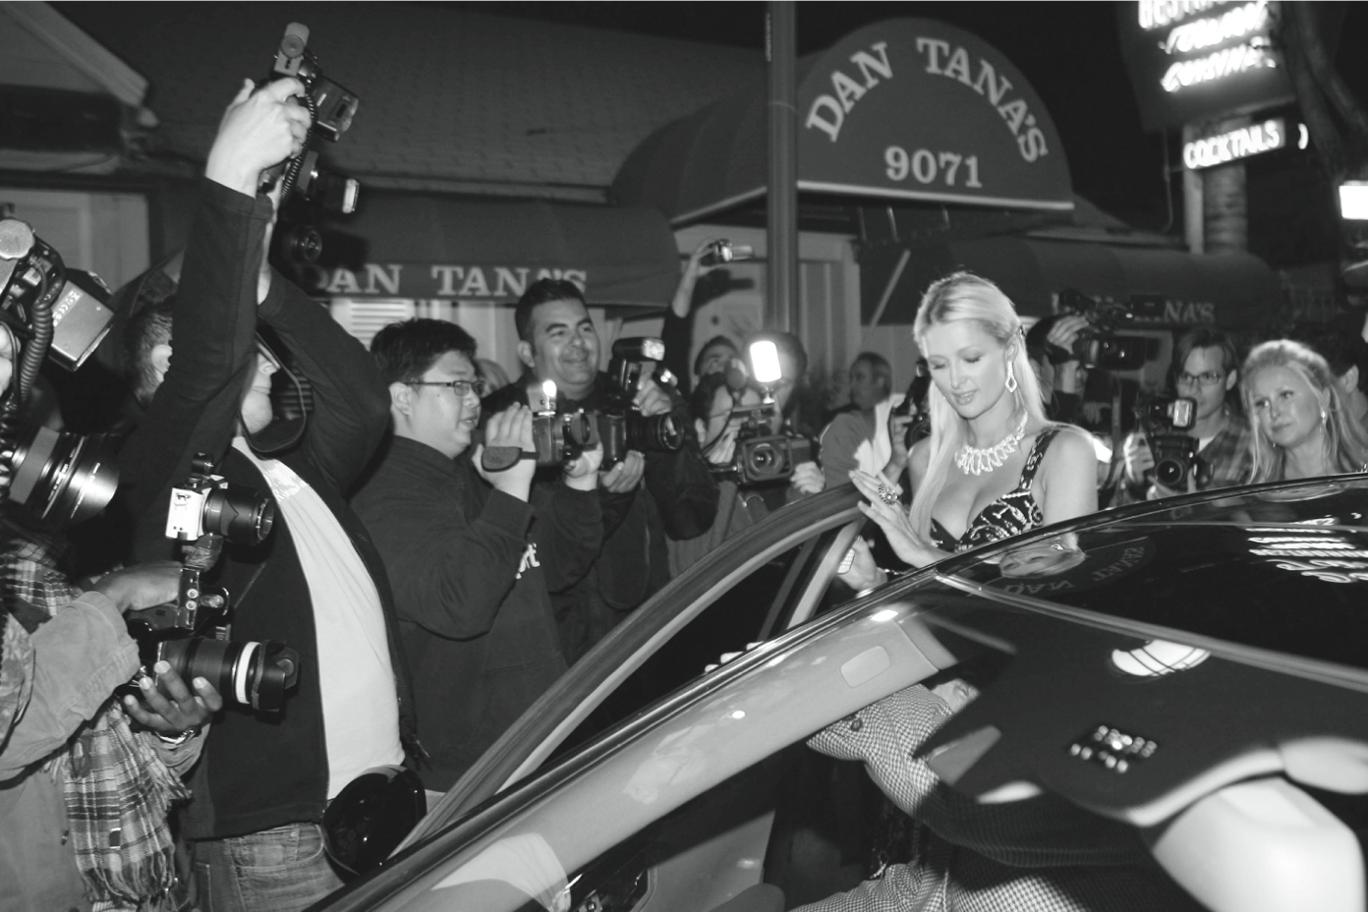
Debate: Do People Have the Right to Be Left Alone?
PhamousFotos / Splash News/Newscom

Slide 114
Debate: If we are always being recorded, people will behave better and be punished more justly.
Marge Simpson: “you know the courts might not work anymore, but as long as everyone is always taping everyone else – justice will be done.”

Slide 115
Privacy and Trust
Perhaps modern life is actually more private than life centuries ago
Most people don’t live with extended families
Automobile allows us to travel alone
Television v. public entertainment
Challenge: we now live among strangers
Remedy: establishing reputations
Ordeal, such as lie detector test or drug test
Credential, such as driver’s license, key, ID card, college degree
Establishing reputation is done at the cost of reducing privacy

Slide 116
5.4 Data Mining

Slide 117
Data Mining Defined
Searching records in one or more databases, looking for patterns or relationships
Can be used to create profiles of individuals
Allows companies to build more personal relationships with customers

Slide 118
Google’s Personalized Search
Secondary use: Information collected for one purpose use for another purpose
Google keeps track of your search queries and Web pages you have visited
It uses this information to infer your interests and determine which pages to return
Example: “bass” could refer to fishing or music
Also used by retailers for direct marketing

Slide 119
Secondary Uses of Information

Slide 120
Collaborative Filtering
Form of data mining
Analyze information about preferences of large number of people to predict what one person may prefer
Explicit method: people rank preferences
Implicit method: keep track of purchases
Used by online retailers and movie sites

Slide 121
Unintended consequences of collaborative filtering.
XS - might this promote stereotypes in predictive search algorithms? What other effects might it have? Are these the programmers’ responsibility?

Slide 122
Ownership of Transaction Information
Who controls transaction information?
Buyer?
Seller?
Both?
Opt-in: Consumer must explicitly give permission before the organization can share info
Opt-out: Organization can share info until consumer explicitly forbid it
Opt-in is a barrier for new businesses, so direct marketing organizations prefer opt-out

Slide 123
Targeting Pregnant Women
Most people keep shopping at the same stores, but new parents have malleable shopping habits
Targeting pregnant women a good way to attract new customers
Target did data mining to predict customers in second trimester of pregnancy
Large amounts of unscented lotion, extra-large bags of cotton balls, nutritional supplements
Mailings included offers for unrelated items with offers for diapers, baby clothes, etc.

Slide 124
Credit Reports
Example of how information about customers can itself become a commodity
Credit bureaus
Keep track of an individual’s assets, debts, and history of paying bills and repaying loans
Sell credit reports to banks, credit card companies, and other potential lenders
System gives you more choices in where to borrow money
Poor credit can hurt employment prospects

Slide 125
Targeted Direct Mail
Businesses mail advertisements only to those most likely to purchase products
Data brokers provide customized mailing lists created for information gathered online and offline
Example of making inferences for targeted direct mail
Shopping for clothes online + frequent fast-food dining + subscribing to premium cable TV channels → more likely to be obese
Two shoppers visiting same site may pay different prices based on inferences about their relative affluence

Slide 126
XS – personalized markets
Free markets function on the basis of common prices that give consumers equal economic rights.
Is it alright for stores to offer different prices to different people, depending on what it knows about them?
How do you react to sales? Are you rich? What race/age are you?

Slide 127
Microtargeting
Political campaigns determine voters most likely to support particular candidates
Voter registration
Voting frequency
Consumer data
GIS data
Target direct mailings, emails, text messages, home visits to most likely supporters

Slide 128
Social Network Analysis
Collect information from social networks to inform decisions
Bharti Airtel (India) offers special promotions to “influencers”
Police use Facebook and Twitter posts to deploy officers on big party nights
Banks combine social network data with credit reports to determine creditworthiness

Slide 129
Netflix Prize
Netflix offered $1 million prize to any group that could come up with a significantly better algorithm for predicting user ratings (2006)
Released more than 100 million movie ratings from a half million customers
Stripped ratings of private information
Researchers demonstrated that ratings not truly anonymous if a little more information from individuals was available
U.S. Federal Trade Commission complaint and lawsuit
Netflix canceled sequel to Netflix Prize (2010)

Slide 130
AOL Search Dataset
AOL researcher Dr. Chowdhury posted three months’ worth of user queries from 650,000 users (2006)
No names used; random integers used to label all queries from particular users
Researchers identified some users from queries; e.g., many people performed searches on their own names
New York Times investigation led to public outcry
AOL took down dataset, but already copied and reposted
AOL fired Dr. Chowdhury and his supervisor
Xs – play User 927 – based on a user’s search history.

Slide 131
Chapter 6

Slide 132
Predictive Policing
Criminals behave in a predictable way
Times of crimes fall into patterns
Some areas have higher incidence of crimes
Predictive policing: use of data mining to deploy police officers to areas where crimes are more likely to occur
Police in Santa Cruz and Los Angeles saw significant declines in property crime

Slide 133
Potential Harms of Profiling
Government security agencies supposed to protect nation from harm
What if an erroneous profile characterizes an innocent citizen as a potential terrorist?
May be impossible to explain how an algorithm has put someone on the watch list
US government’s terrorist watch list now contains 1.5 million names
How can innocent people clear their names?

Slide 134
Legislation for Private Institutions
Fair Credit Reporting Act
Fair and Accurate Credit Transactions Act
Financial Services Modernization Act

Slide 135
Fair Credit Reporting Act
Promotes accuracy and privacy of information used by credit bureaus
Major credit bureaus: Equifax, Experian, Trans Union
Negative information kept only 7 years
Exceptions
Bankruptcies: 10 years
Criminal convictions: indefinitely

Slide 136
Fair and Accurate Credit Transactions Act
Passed in 2004
Requires three major credit bureaus to provide consumers a free copy of their credit report every 12 months
Not automatic: consumers must request credit reports
Provisions to reduce identity theft

Slide 137
Financial Services Modernization Act
Also called Gramm-Leach-Bliley Act of 1999
Creates “financial supermarkets” offering banking, insurance, and brokerage services
Privacy-related provisions
Privacy policies must be disclosed to customers
Notices must provide an opt-out clause
Companies must develop procedures to protect customers’ confidential information

Slide 138
6.9 National Identification Card

Slide 139
Social Security Number
Social Security cards first issued 1936
Originally used only for Social Security purposes
Use of SSN has gradually increased
SSN is a poor identification number
Not unique
Rarely checked
No error-detecting capability

Slide 140
Arguments for National ID Card
Current ID cards are second-rate
Would reduce illegal entry to US
Would prevent illegal aliens from working
Would reduce crime
Other democratic countries have national ID cards

Slide 141
Arguments against National ID Card
No card positively guarantees identification
No biometric-based system is 100% accurate
No evidence it will reduce crime
Makes government data mining simpler
Make law-abiding people more vulnerable to fraud and indiscretions

Slide 142
The REAL ID Act
Signed in May 2005
Significantly changes driver’s licenses in the United States
New licenses
Issued by end of 2013
Required to open bank account, fly on commercial airplane, or receive government service
Requires applicants to supply 4 different IDs
Will probably contain a biometric identifier
Must contain data in machine-readable form
Most states missed 2013 deadline; temporary deferments being granted

Slide 143
Possible Consequences of New Licenses
Better identification means better law enforcement
People won’t be able to change identities
Parents ducking child support
Criminals on the run
New, centralized databases could lead to more identity theft

Slide 144
Chapter 7

Slide 145
7.3 Malware

Slide 146
Viruses
Virus: Piece of self-replicating code embedded within another program (host)
Viruses associated with program files
Hard disks, floppy disks, CD-ROMS
Email attachments
How viruses spread
Diskettes or CDs
Email
Files downloaded from Internet

Slide 147
One Way a Virus Can Replicate

Slide 148
Email Attachment with Possible Virus

Slide 149
How an Email Virus Spreads

Slide 150
Antivirus Software Packages
Allow computer users to detect and destroy viruses
Must be kept up-to-date to be most effective
Many people do not keep their antivirus software packages up-to-date
Consumers need to beware of fake antivirus applications

Slide 151
Worm
Self-contained program
Spreads through a computer network
Exploits security holes in networked computers

Slide 152
How a Worm Spreads

Slide 153
The Internet Worm
Robert Tappan Morris, Jr.
Graduate student at Cornell
Released worm onto Internet from MIT computer
Effect of worm
Spread to significant numbers of Unix computers
Infected computers kept crashing or became unresponsive
Took a day for fixes to be published
Impact on Morris
Suspended from Cornell
3 years’ probation + 400 hours community service
$150,000 in legal fees and fines

Slide 154
Ethical Evaluation
Kantian evaluation
Morris used others by gaining access to their computers without permission
Social contract theory evaluation
Morris violated property rights of organizations
Utilitarian evaluation
Benefits: Organizations learned of security flaws
Harms: Time spent by those fighting worm, unavailable computers, disrupted network traffic, Morris’s punishments
Virtue ethics evaluation
Morris selfishly used Internet as experimental lab
He deceitfully released worm from MIT instead of Cornell
He avoided taking responsibility for his actions
Morris was wrong to have released the Internet worm

Slide 155
Sasser Worm
Launched in April 2004, infected 18 million computers
Disrupted operations at Delta Airlines, European Commission, Australian railroads, British coast guard
German juvenile Sven Jaschan confessed to crime
Sentenced to 30 hours of community service and 18 months’ probation

Slide 156
Instant Messaging Worms
Choke and Hello (2001)
Kelvir (2005)
Reuters had to remove 60,000 subscribers from its instant messaging service
Palevo (2010)
Spread through Romania, Mongolia, Indonesia

Slide 157
Conficker Worm
Conficker (a.k.a. Downadup) worm appeared 2008 on Windows computers
Particularly difficult to eradicate
Millions of copies of worm are circulating
Purpose of worm still unknown

Slide 158
Cross-site Scripting
Another way malware may be downloaded without user’s knowledge
Problem appears on Web sites that allow people to read what others have posted
Attacker injects client-side script into a Web site
Victim’s browser executes script, which may steal cookies, track user’s activity, or perform another malicious action

Slide 159
Drive-by Downloads
Unintentional downloading of malware caused by visiting a compromised Web site
Also happens when Web surfer sees pop-up window asking permission to download software and clicks “Okay”
Google Anti-Malware Team says 1.3 percent of queries to Google’s search engine return a malicious URL somewhere on results page

Slide 160
Trojan Horses and Backdoor Trojans
Trojan horse: Program with benign capability that masks a sinister purpose
Backdoor Trojan: Trojan horse that gives attack access to victim’s computer

Slide 161
Phishing and Spear-phishing
Phishing: Large-scale effort to gain sensitive information from gullible computer users
At least 67,000 phishing attacks globally in second half of 2010
New development: phishing attacks on Chinese e-commerce sites
Spear-phishing: Variant of phishing in which email addresses chosen selectively to target particular group of recipients

Slide 162
7.5 Online Voting

Slide 163
Motivation for Online Voting
2000 U.S. Presidential election closely contested
Florida pivotal state
Most Florida counties used keypunch voting machines
Two voting irregularities traced to these machines
Hanging chad
“Butterfly ballot” in Palm Beach County

Slide 164
The Infamous “Butterfly Ballot”
AP Photo/Gary I. Rothstein

Slide 165
Benefits of Online Voting
More people would vote
Votes would be counted more quickly
No ambiguity with electronic votes
Cost less money
Eliminate ballot box tampering
Software can prevent accidental over-voting
Software can prevent under-voting

Slide 166
Risks of Online Voting
Gives unfair advantage to those with home computers
More difficult to preserve voter privacy
More opportunities for vote selling
Obvious target for a DDoS attack
Security of election depends on security of home computers
Susceptible to vote-changing virus or RAT
Susceptible to phony vote servers
No paper copies of ballots for auditing or recounts

Slide 167
Utilitarian Analysis
Suppose online voting replaced traditional voting
Benefit: Time savings
Assume 50% of adults actually vote
Suppose voter saves 1 hour by voting online
Average pay in U.S. is $21.00 / hour
Time savings worth $10.50 per adult American
Harm of DDoS attack difficult to determine
What is probability of a DDoS attack?
What is the probability an attack would succeed?
What is the probability a successful attack would change the outcome of the election?

Slide 168
Kantian Analysis
The will of each voter should be reflected in that voter’s ballot
The integrity of each ballot is paramount
Ability to do a recount necessary to guarantee integrity of each ballot
There should be a paper record of every vote
Eliminating paper records to save time and/or money is wrong

Slide 169
Conclusions
Existing systems are highly localized
Widespread tainting more possible with online system
No paper records with online system
Evidence of tampering with online elections
Relying on security of home computers means system vulnerable to fraud
Strong case for not allowing online voting

Slide 170
Chapter 8

Slide 171
Validating Simulations
Verification: Does program correctly implement model?
Validation: Does the model accurately represent the real system?
Validation methods
Make prediction, wait to see if it comes true
Predict the present from old data
Test credibility with experts and decision makers

Slide 172
8.7 Software Engineering

Slide 173
Specification
Determine system requirements
Understand constraints
Determine feasibility
End products
High-level statement of requirements
Mock-up of user interface
Low-level requirements statement

Slide 174
Development
Create high-level design
Discover and resolve mistakes, omissions in specification
CASE tools to support design process
Object-oriented systems have advantages
After detailed design, actual programs written
Result: working software system

Slide 175
Validation (Testing)
Ensure software satisfies specification
Ensure software meets user’s needs
Challenges to testing software
Noncontinuous responses to changes in input
Exhaustive testing impossible
Testing reveals bugs, but cannot prove none exist
Test modules, then subsystems, then system

Slide 176
Software Quality Is Improving
Standish Group tracks IT projects
Situation in 1994
1/3 projects cancelled before completion
1/2 projects had time and/or cost overruns
1/6 projects completed on time and on budget
Situation in 2009
1/4 projects cancelled
5/12 projects had time and/or cost overruns
1/3 projects completed on time and on budget

Slide 177
Success of IT Projects Over Time

Slide 178
Gender Bias
In male-dominated fields, unconscious gender bias can affect important design decisions
Example: seatbelts don’t work well for pregnant women and their unborn children because crash dummies are modeled after men
Men and women have different approaches to writing and debugging software and using programming tools
Even if women present, their voices may not be heard
Voting suppresses minority views
Many decisions made under time pressure
Solutions
Attract more women by improving job postings
Assign mentors, eliminate sexual harassment

Slide 179
Chapter 9

Slide 180
Case Study: Certified Public Accountants
Bachelor’s degree
150+ semester hours
24+ hours of accounting-related classes
Two years’ experience working under supervision of a CPA
CPA exam
To retain certification
Continuing education
Follow code of ethics

Slide 181
How Do Computer-Related Careers Stack Up?
Certification and licensing not required
College degree not required
Apprenticeship not required
Membership in professional society optional
No specific requirements for continuing education
Most computer programmers, system analysts, etc. are part of teams

Slide 182
Status of Certification and Licensing
Software engineer: someone engaged in development or maintenance of software, or teaches in this area
Path to certification now exists: similar to path taken by engineers in other disciplines, such as civil engineering
Four years of post-college work experience
Pass Fundamentals of Engineering (FE) exam
Pass discipline-specific Principles and Practice of Engineering (PE) exam
PE exam in software available since 2013
Only a very small percentage of software engineers will have to be licensed
Those developing software that can affect health, safety, and welfare of the public
Those offering their services directly to the public

Slide 183
Ability to Harm Public
Many computer professionals hold responsibilities similar to those held by members of mature professions
Therac-25 killed or gravely injured at least six people
Millions rely upon software rather than accountants to prepare their tax returns
Millions of people rely on system administrators to keep their work-related information secure

Slide 184
The Importance of Taking Personal Responsibility
The ability to cause harm to members of the public is a powerful reason why those in computer-related careers must act according to ethical principles. Without universal certification and licensing and other components of a well-developed profession to rely upon, those in computer-related careers must take more personal responsibility for developing their ethical decision-making skills.

Slide 185
Eight Principles Identify Morally Responsible Relationships
Public
Client and employer
Product
Judgment
Management
Profession
Colleagues
Self

Slide 186
9.6 Whistle-blowing

Slide 187
Overview of Whistle-blowing
Whistle-blower
Tries to report harmful situation through authorized channels
Rebuffed by organization
Makes disclosure through unauthorized channels
Whistle-blowers punished for their actions
Lose job or all chances of advancement
Financial and emotional hardship
False Claims Act
Whistleblower Protection Act

Slide 188
Motives of Whistle-blowers
People become whistle-blowers for different reasons
Morality of action may depend on motives
Good motive
Desire to help the public
Questionable motives
Retaliation
Avoiding punishment

Slide 189
Whistle-blowing as Moral Duty
Richard DeGeorge’s questions for whistle-blowing
Is serious harm to the public at stake?
Have you told your manager?
Have you tried every possible inside channel?
Do you have persuasive documented evidence?
Are you sure whistle-blowing will work?
Under what conditions must you blow the whistle?
DeGeorge: If all five conditions are met
Others: If conditions 1-3 are met
Still others: Whistle-blowing is never morally required

Slide 190
Moral Responsibility
Exclusive Responsibilities
Role responsibility
Causal responsibility
Legal responsibility
Moral responsibility
Must be borne by people
Is not exclusive
Michael McFarland: A team should be held to a higher level of moral responsibility than any of its members

Slide 191
Paternalism
Roughly the interference with a person’s liberty of action justified by reasons referring exclusively to the welfare, good, happiness, needs, interests or values of the person being coerced” (Gerald Dworkin, Morality, Harm and the Law).

Slide 192
Soft vs. Hard Paternalism
Soft paternalism: paternalism is justified on the basis of informing people of the dangers/harms they face. But it allows them to face them so long as there is no other harm (e.g. cigarette labels). Seems to adhere to the core ideas behind the harm principle – according to JS Mill.
Hard paternalism: paternalism is justified even in some situations where a person knows the danger/harm, but wants to proceed anyways (e.g. healthcare).

Slide 193
Pure vs. Impure Paternalism
Pure Paternalism: only those people who are being protected have their liberty impeded. (e.g. laws requiring bike helmets)
Impure Paternalism: a wider class of people have restrictions put on their liberty. (e.g. cigarette manufacturers)

Slide 194
Moral Paternalism
“The usual justification for paternalism refers to the interests of the person being interfered with. These interests are defined in terms of the things that make a person’s life go better; in particular their physical and psychological condition. It is things like death or misery or painful emotional states which are in question. Sometimes, however, advocates of state intervention seek to protect the moral welfare of the person. So, for example, it may be argued that prostitutes are better off being prevented from plying their trade even if they make a decent living and their health is protected against disease. They are better off because it is morally corrupting to sell one’s sexual services. The interference is justified, therefore, to promote the moral well-being of the person. This then can be called moral paternalism” (G. Dworkin, Stanford Encyclopedia of Philosophy, 2017).

Slide 195
Ethics and Punishment
Social Contract Theory: Law must be prospective, positive, and promulgated/popularized.
Kant: Law’s purpose is to punish transgressors.
Utilitarianism: Law’s purpose is to improve society.

Slide 196
Social Rights
When someone contends that the harmful behaviour of others harms me socially. For example, allowing people to drink alcohol. (J.S. Mill opposed – too broad).

Slide 197
Utilitarian Reasons for Punishment
Retribution
Restore
Rehabilitate
Remove
Deter

Slide 198
Chapter 10

Slide 199
10.3 Workplace Changes

Slide 200
Organizational Changes
Information technology integration into firms
Automating back office functions (e.g., payroll)
Improving manufacturing
Improving communication among business units
Results
Flattened organizational structures
Eliminating transactional middlemen (supply-chain automation)

Slide 201
Inexpensive Interactions Lead to Flexible Information Flow

Slide 202
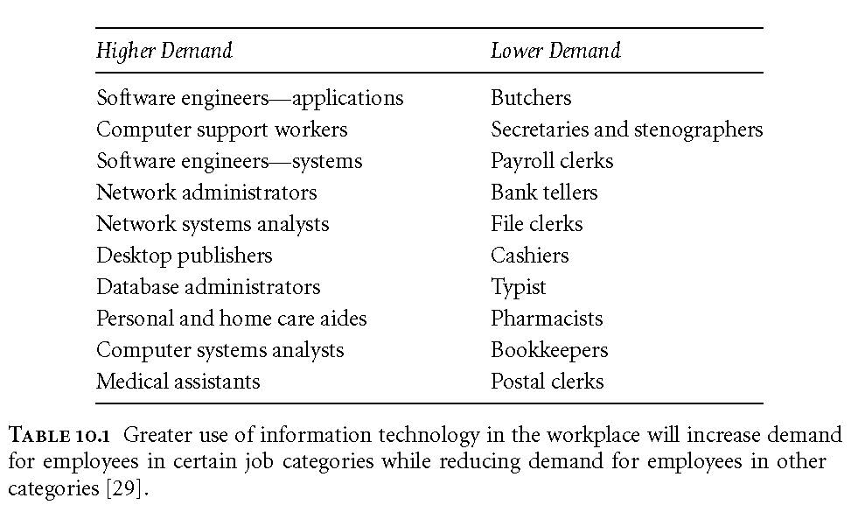
Winners, Losers in the Workplace of the Future
<Insert Table 10.1 here>

Slide 203
Telework
Employees work away from traditional place of work
Examples
Home office
Commuting to a telecenter
Salespersons with no office
About 37% of Americans do some telework

Slide 204
Advantages of Telework
Increases productivity
Reduces absenteeism
Improves morale
Helps recruitment and retention of top employees
Saves overhead
Improves company resilience
Helps environment
Saves employees money

Slide 205
Disadvantages of Telework
Threatens managers’ control and authority
Makes face-to-face meetings impossible
Sensitive information less secure
Team meetings more difficult
Teleworkers less visible
Teleworkers “out of the loop”
Isolation of teleworkers
Teleworkers work longer hours for same pay

Slide 206
The Gig Economy (1/3)
Companies less committed to employees
Lay-offs not taboo as they once were
Companies hiring more subcontractors and temporary employees
Saves money on benefits
Makes it easier to downsize

Slide 207
The Gig Economy (2/3)
Some start-ups make money by connecting people who want a service with people willing to provide that service
Gig economy: Service workers making a living by completing short-term jobs for clients
Examples
Uber, Lyft: Connect riders and drivers
Instacart: Grocery delivery service
Airbnb: Connect travelers and those with accommodations

Slide 208
The Gig Economy (3/3)
Proponents say workers gain independence, flexibility
Critics say these are last-resort jobs and competition among workers drives down wages
Robert Reich: “The big money goes to the corporations that own the software. The scraps go to the on-demand workers.”
Uber and Lyft drivers filed lawsuits to be classified as employees

Slide 209
Monitoring (1/2)
Two-thirds of companies monitor Internet use of their employees
Other examples of monitoring
Video surveillance
Monitoring keyboard activity
Monitoring time spent on phone
Monitoring emails
Purpose: Identify inappropriate use of company resources
Can also detect illegal activities

Slide 210
Monitoring (1/2)
Other uses of monitoring
Gauge productivity
Improve productivity
Improve security; i.e., in schools
Evidence that monitoring…
Makes employees more focused on work
Reduces job satisfaction

Slide 211
10.4 Globalization

Slide 212
Globalization Basics
Globalization: Process of creating a worldwide network of businesses and markets
Globalization causes a greater mobility of goods, services, and capital around the world
Globalization made possible through rapidly decreasing cost of information technology

Slide 213
Globalization
Technological
Political
Economic
Cultural

Slide 214

Technological Globalization
Technological Globalization refers to the ways in which technology has made the world seem like a smaller place by connecting us to place around the world.
Transportation has been the primary means of promoting globalization historically. Jules Verne’s 1873 book ‘Around the World in 80 Days’ drew attention to the fact that technology had progressed to the point that one could reliably travel the circumference of the earth, without too much trouble.
The current period of globalization has been driven by communications technology. The flow of information around the world, especially financial flows, are making the world a smaller place.

Slide 215

Political Globalization
Since the world began to become smaller, political leaders have developed international institutions in order to better regulate world affairs.
The United Nations is the most famous of these international organizations and was developed in order to prevent conflicts like World War II from happening again. To do so, it granted veto power to 5 countries: the USA, the UK, France, China, and Russia.
Other international organizations include: the World Trade Organization, the International Monetary Fund, and the General Agreement on Tariffs and Trade.
Regional organizations include: the European Union, the North Atlantic Treaty Organization, and economic treaties such as the US-Canada-Mexico (USCAM) free trade deal and the Trans-Pacific Partnership.

Slide 216
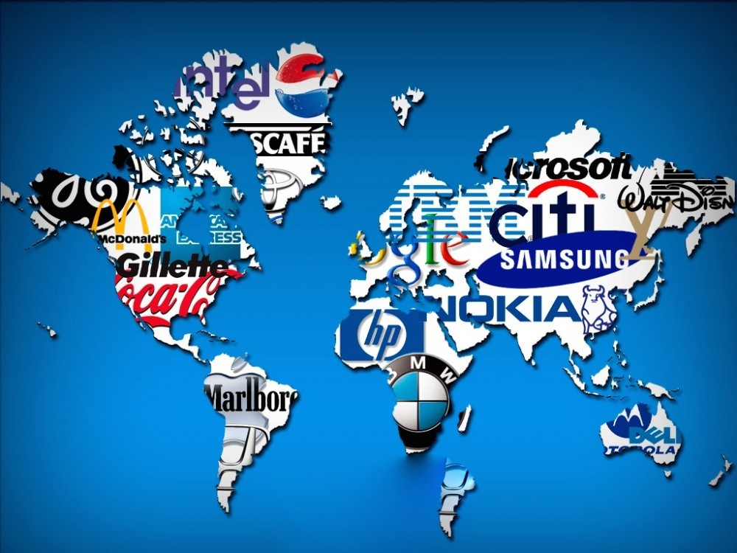
Economic Globalization
Neo-liberalism: “promotes the privatization of state functions, deregulation of trade, and reduction of welfare spending and prioritizes economic over social liberalism” (O’Brien & Szeman 2018, p.394).
Proponents included Prime Minister Brian Mulroney (Canada), President Ronald Reagan (US), and Prime Minister Margaret Thatcher (UK).
Neo-liberalism has increased the inter-dependence of national economies. Some people worry that this has made national governments less able to regulate their own affairs.
Capital flight, whereby companies withdraw their investments from countries that attempt to tax or regulate corporations, is both a cause and effect of globalization.

Slide 217
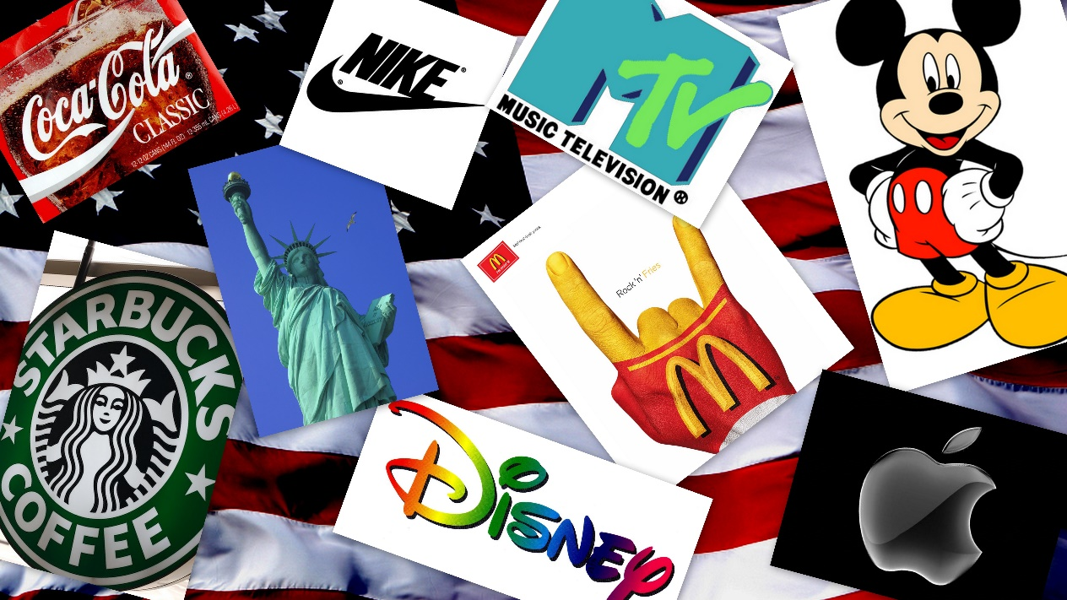
Cultural Globalization
As transit and communication have become easier, culture has spread around the world. This has given rise to worries about cultural imperialism.
Cultural imperialism is when the culture of one area spreads into surrounding areas and displaces the local culture.
For example: of the more than 7000 languages, scholars estimate more than 3,500 of them are in danger. Recall the terrible legacy of residential schools in Canada.
Culture does not merely move from the powerful to the powerless, however. As hip-hop in America has emerged from an oppressed population to dominate American and international culture.

Slide 218
Declines in Computing & Communication Costs Spurred Globalization

Slide 219
Arguments for Globalization
Increases competition
People in poorer countries deserve jobs, too
It is a tried-and-true route for a poor country to become prosperous
Global jobs reduce unrest and increase stability

Slide 220
Arguments against Globalization
Makes the United States subordinate to the World Trade Organization
Forces American workers to compete with foreigners who do not get decent wages and benefits
Accelerates exodus of manufacturing and white-collar jobs from United States
Hurts workers in foreign countries
XS: Race to the bottom (countries compete for companies).

Slide 221
10.5 The Digital Divide

Slide 222
Concept of the Digital Divide
Digital divide: Some people have access to modern information technology while others do not
Underlying assumption: people with access to telephones, computers, Internet have opportunities denied to those without access
Concept of digital divide became popular with emergence of World Wide Web

Slide 223
Evidence of the Digital Divide
Global divide
Access higher in wealthy countries
Access higher where IT infrastructure good
Access higher where literacy higher
Access higher in English-speaking countries
Access higher where it is culturally valued
Social divide
Access higher for young people
Access higher for well-educated people

Slide 224
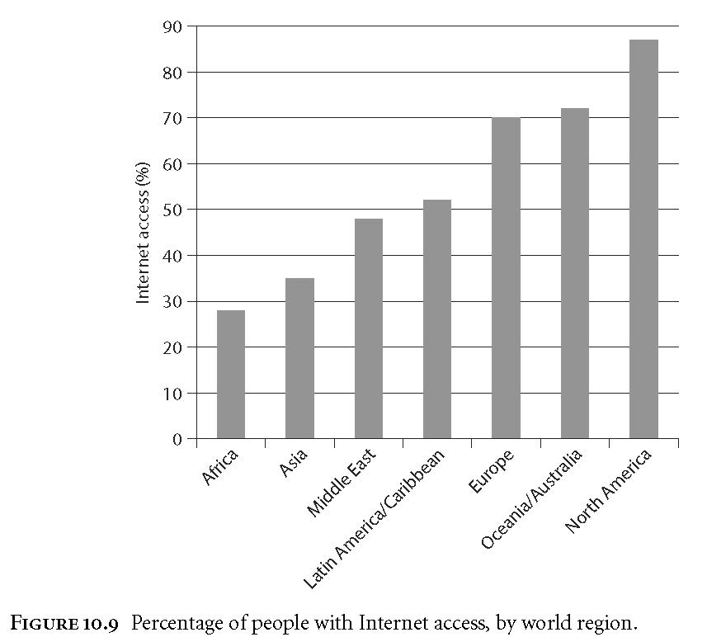
Percentage of People with Internet Access, by World Region

Slide 225
Models of Technological Diffusion
Technological diffusion: rate at which a new technology is assimilated
Group A: highest socioeconomic status
Group B: middle socioeconomic status
Group C: lowest socioeconomic status
Normalization model
Group A adopts first, then Group B, finally Group C
Eventually A use = B use = C use
Stratification model
Group A adopts first, then Group B, finally Group C
A use > B use > C use forever

Slide 226
Two Models for Technological Diffusion

Slide 227
Critiques of the Digital Divide
DD talk suggests the difference between “haves” and “have nots” is simply about access
DD talk puts everyone in two categories, but reality is a continuum
DD implies lack of access leads to less advantaged social position, but maybe it is the other way around
Internet is not the pinnacle of information technology

Slide 228
Massive Open Online Courses
Rate of tuition increases at US universities has exceeded inflation for several decades
Financing college education increasingly difficult for poorer families
Free massive open online courses (MOOCs) promoted as a way to make higher education more affordable
Study by Community College Research Center
Students less likely to complete and do well in MOOCs than traditional courses
MOOCs widen achievement gap between white and black students and between those with higher GPAs and those with lower GPAs

Slide 229
Net Neutrality
Tiered service: Charging more for high-priority routing of Internet packets
Supporters of tiered service say it is needed to support Voice-over-IP and other services
Opponents to tiered service (e.g., Google, Yahoo!) say it would hurt small start-up companies and lower innovation
Other critics believe companies controlling Internet might favor some content over other content
Net neutrality legislation would require all Internet packets be treated the same
Opponents of proposed legislation say consumers should be able to pay more to get higher quality service; e.g., those doing video conferencing willing to pay more than those sending email
February 2015: FCC issued the Open Internet Order to preserve net neutrality; the ruling being challenged by lawsuits

Slide 230
10.6 The “Winner-Take-All Society”

Slide 231
Income Inequality
Survey Class.
5 groups: Poorest, Poor, Medium, Wealthy, Wealthiest.
What do you think the ideal distribution should be?
(e.g. Poorest:5%, Poor: 10%, Medium:20%, Wealthy: 30%, Wealthiest: 35)
What is the actual distribution of each groups share of wealth?
Income Inequality in America

Slide 232
The Winner-Take-All Phenomenon
Winner-take-all: a few top performers have disproportionate share of wealth
Causes
IT and efficient transportation systems
Network economies
Dominance of English language
Changing business norms

Slide 233
CEO Pay v. Production Worker Pay, 1980 and 2003

Slide 234
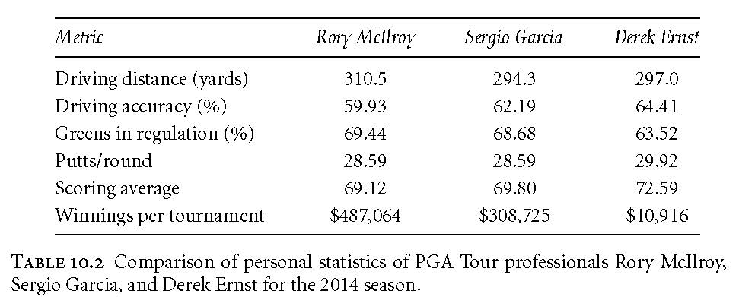
Is Rory McIlroy That Much Better Than Sergio Garcia or Derek Ernst?
<Insert Table 10.2 here>

Slide 235
Reducing Winner-Take-All Effects
Limit number of hours that stores remain open
Businesses form cooperative agreements to reduce positional arms races
Example: salary caps on pro sports teams
More progressive tax structures
Campaign finance reform

Slide 236
Fake News

Slide 237
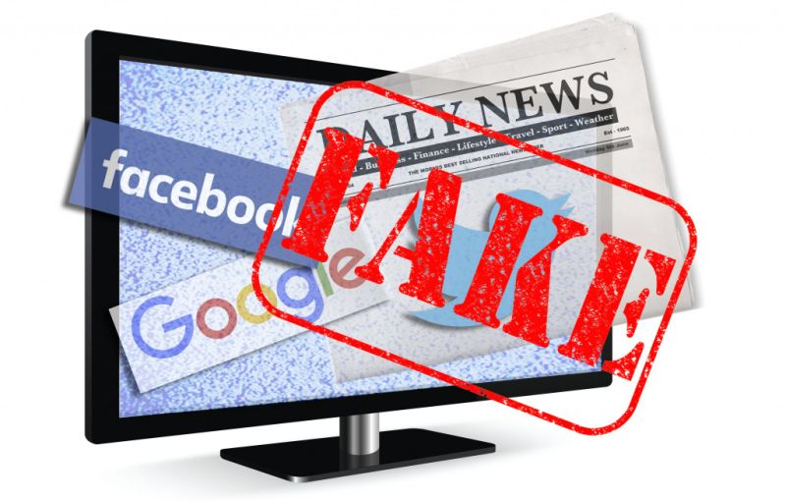
Fake News

Slide 238
Agenda
Propaganda Model
Fake News - Causes and Effects
Movies and Books for Students

Slide 239
Review
Fill in the blanks: 10/12 (1 each, 10 points total)
Short answers: 5/7 (3 each, 15 points total)
Scenario: ½ (5 points total)
Weight: 30%

Slide 240
Review cont.’d
Exam focuses on latter half of the course.
Section 2 of the Charter is on the exam.

Slide 241
Course Evaluation
Would it have been helpful to break the essay down into smaller parts? (e.g. a separate assignment to have you gather sources, find strong quotes, write an introduction, and finally submit it)
What could be done to encourage more student participation?
Do you wish more time was spent on review?
What was your favorite thing about class?
What was your least favorite thing about class?

Slide 242
Chomsky and Herman’s Propaganda Model
Edward S. Herman and Noam Chomsky wrote Manufacturing Consent in 1988. It saw the ‘free press’ of the United States as subject to corporate interests. These interests seek to promote capitalist propaganda through 5 filters.
Media ownership – mass media is expensive and overwhelmingly owned by corporate interests.
Advertising – consumers are unwilling to pay for the expenses of media and they are therefore reliant on advertising.
Complicity – reporters are encouraged to report the official consensus or have their access to those in power cut.
Flak – when people put out reports that corporate interests don’t like, they are able to lobby the broadcaster and disparage the reporter.
The Common enemy – when people are upset at the status quo, they are pointed towards an official enemy to direct their anger.

Slide 243
Has the internet changed the validity of this model?
Has it disrupted the importance of:
Media ownership?
Advertising?
Complicity?
Flak?
The Common enemy?

Slide 244
How has the internet shifted who has power over information?
Anyone can post anything.
We get much of our news from our friends, rather than governments or media corporations.

Slide 245
Fake News
Fake news is: “news articles that are intentionally and verifiably false, and could mislead readers” (Allcott & Gentzkow 2017, p.213).
This does not include (according to Allcott and Gentzkow):
Unintentional reporting mistakes
Rumors that do not originate from a particular news article
Conspiracy theories
Satire
False statements by politicians
Slanted or misleading news

Slide 246
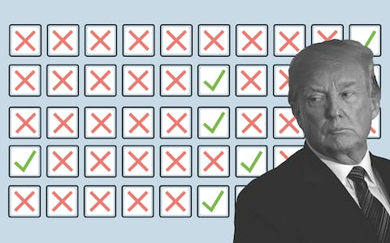
Social Costs of Fake News
Consumers who mistake fake news for real news have less accurate beliefs.
Less accurate beliefs cause social problems (e.g. democratic selection of inferior candidates).
Consumers become skeptical of legitimate news outlets.
Reduced demand for accuracy in reporting will reduce the incentive of news outlets to invest in accuracy.

Slide 247
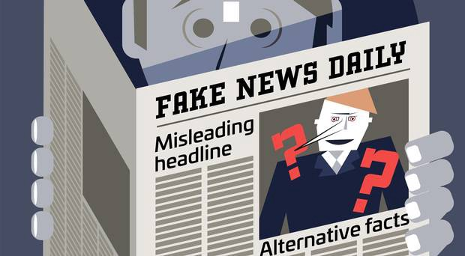
Causes of Fake News
Fake news is cheaper to provide than real news (no paying fact checkers, etc.).
The cost to produce news has gone down, allowing many to enter it.
Social media use has increased and is an ideal transmitter of fake news.
Consumers cannot costlessly infer the accuracy of fake news.
Consumers enjoy partisan news and increasingly enjoy putting down other political ideologies.

Slide 248
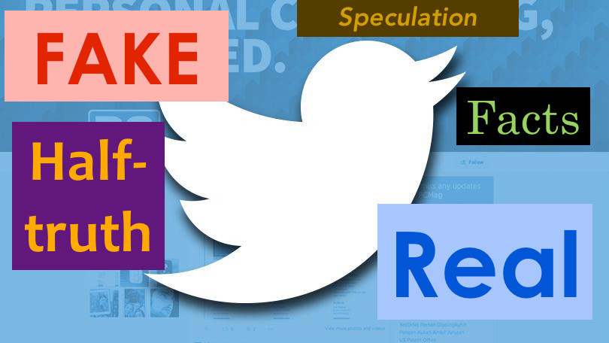
Social Media and Fake News
Social media platforms are conducive to fake news for several reasons:
The cost of creating content and putting it out there are minute.
The format of social media (small bit of information – often viewed on a phone) makes it harder to spot fakes.
Facebook friend networks are ideologically segregated (median share of friends with the opposite ideology is only 20% for liberals, 18% for conservatives).

Slide 249
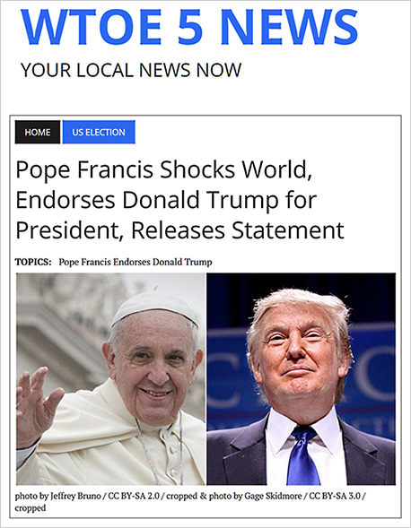
WTOE 5 has since been discontinued.
Most shared fake news story of the 2016 election. If fake news did have an impact on the election (which many, including Allcott and Gentzkow argue against), this was probably the most effective story.

Slide 250
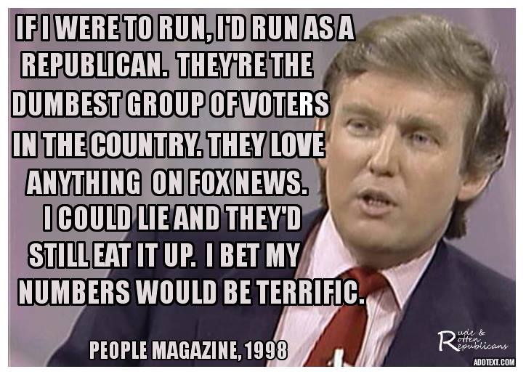
Democrats were not immune to fake news.
This (false) quote and photo were frequently shared amongst ideological liberals on Facebook.

Slide 251
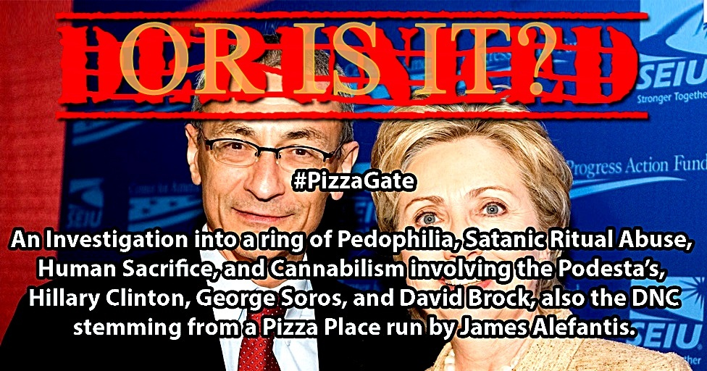
Truly Crazy Fake News

Slide 252
How do fake news and mental illness interact?

Slide 253
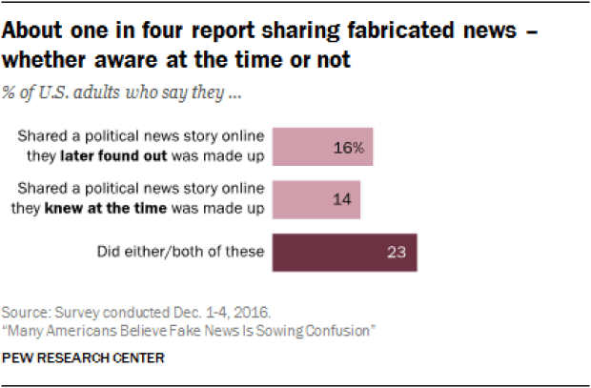
Current Trends in Fake News
62% of Americans get their news from social media.
The most popular fake news stories were shared on Facebook more often than the most popular mainstream news stories.
Many people who see fake news stories report that they believe them.
The most discussed stories tend to favor Donald Trump over Hillary Clinton.
- (Allcott and Gentzkow 2017).

Slide 254
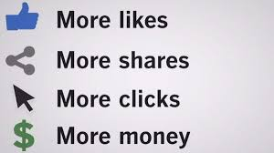
Motivations of Fake News
Money – having a news story go viral can earn purveyors of fake news a lot of money in advertising. For example, more than 100 news sites were run by teenagers in Macedonia trying to rack of views to make money.
Ideology – people knowingly spread fake news in order to back their own ideological supporters at the expense of political opponents.

Slide 255
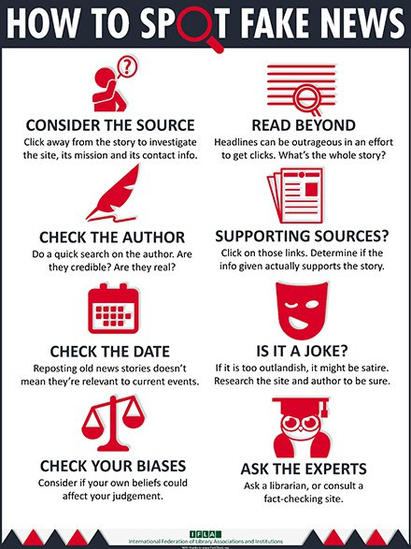
What can be done?
“In theory, a social planner should want to address the market failures that lead to distortions, which would take the form of increasing information about the state of the world and increasing incentives for news consumers to infer the true state of the world” (Allcott & Gentzkow 2017, p. 232).
Being less ideologically inclined made readers more likely to see through false stories – as did education.

Slide 256
TV and Movies for Students
The Wire (HBO 2002-2008): Best show ever. Police drama that follows both cops and criminals set in Baltimore.
Malcolm X
Fight Club
Persepolis: Cartoon Movie about a woman growing up in Iran.
V for Vendetta: Set in a dystopian world, a fun revenge-movie about a revolution that overthrows an authoritarian regime.
The Corporation (documentary – available on YouTube)
Roots (story of slavery, told over several generations)
Atlanta (FX 2016-present): Donald Glover’s show about managing a rap career in Atlanta. It has lots of nuance and willing to experiment with style.
Shawshank Redemption
Rick and Morty (Adult Swim): Cartoon with lots of incredible, high concept Sci-Fi.
Moonlight (2016 triple Oscar winner): Race and Sexuality
Waking Life (Animated movie that does a quick overview of many philosophical theories of life and death).
Little Miss Sunshine
Crash (Racism and Racial Bias in America)
Honorable Mention: The Truman Show/Into the Wild -> both on lots of lists of ‘lifechanging movies’.

Slide 257
Books for Students
Siddhartha: Very short and easy to read. Gives you an idea of the basics of Buddhism.
Ishmael: Human supremacy as a cultural myth.
Animal Farm: George Orwell’s classic novella about authoritarianism and both the need for and dangers of revolutions.
Persepolis: the comic of the movie mentioned above, by Marjane Satrapi.
Autobiography of Malcolm X
Crime and Punishment: Dostoyevsky’s psychological thriller about murder and ethics.
Grapes of Wrath. John Steinbeck’s novel of a family’s journey to California in search of work.
Civil Disobedience. Book by Henry David Thoreau, written when he went to prison for refusing to pay taxes to fund the Mexican-American War.

Slide 258
Canadian Charter of Rights
Canadian Charter: Everyone has the following fundamental freedoms:
freedom of conscience and religion;
freedom of thought, belief, opinion and expression, including freedom of the press and other media of communication;
freedom of peaceful assembly; and
freedom of association.

Slide 259
Scenario 1: Joan takes over as CEO of a cell-phone company, Xofo, that has become very popular. At the same time, people begin to pressure Xofo to stop doing business with a corrupt government that provides them with a rare mineral for gross human rights abuses in the mining sector. Joan can choose to use a different (more ethically sourced) mineral, but costs will go up and battery quality will go down. Also, a competitor of Xofo has started talks with the corrupt government to start getting the mineral. What should Joan do?

Slide 260
Scenario 2: Jack is a young computer hacker who hears a sad story about child abduction and wants to make a difference. He doesn’t meet the physical requirements to become a police officer and decides to hunt child predators on the internet. He impersonates child-predators online and then gains access to their system where he finds child-pornography and publishes their information online. Over a year, this leads to 23 arrests and convictions of child abusers. One of the people that he doxes turns out to be innocent (photos were taken by the computer’s previous owner) and the police begin to hunt the vigilante who is doxing people. Jack has the choice to turn himself in or stay in hiding. What should he do?

